Slide 1



Software Project Management Plan on “Durst SMARTSHOP”
Date: Tuesday 16, 2021
By: Himanshu Sharma

Slide 2
Acronyms
IEEE
Software Project Management Plan
Software Project Management Plan In Action
Summary
References

Slide 3

IEEE – The Institute for Electrical and Electronics Engineering
SPMP – Software Project Management Plan

Slide 4
VISION
To advance global prosperity by fostering technological innovation, enabling members' careers and promoting community world-wide.
MISSION
The IEEE promotes the engineering process of creating, developing, integrating, sharing, and applying knowledge about electro and information technologies and sciences for the benefit of humanity and the profession.

Slide 5

Website: http://www.ieee.org
Non-profit, technical professional association
380 000+ members in 150 countries
Holds 300+ major conferences annually
Nearly 900 active standards with 700 under development

Slide 6

Developed within Technical Committees of the IEEE Societies and Standards Coordinating Committees of the IEEE Standards Board
Volunteer without compensation
Use of Standard is voluntary
Standards are subject to review every 5 years

Slide 7

Overview
Scope and References
Definitions
Software Project Management Plans

Slide 8

Introduction
Project Organization
Managerial Process
Technical Process
Work Packages, Schedule, and Budget
Additional Sections

Slide 9
Introduction
Project Overview
Project Deliverables
Evolution of SPMP
References
Definitions and Acronyms

Slide 10
1.1 Project Overview (Page 1 of 2)
Objective: Develop a software product that will assist the customer/client to check the quality of the printed fabric/material purchased and displayed.
Durst Software & Solutions provides smart and simple software solutions to streamline the process from pixel to output and to maximize the print buying experience. The solutions especially tailored for digital printing with accompanying consulting and training services help our customers to improve printing and simplifying business.
Product will perform record keeping how much percent or the category of the defective as well as the reports listing fabrics bought & sold.

Slide 11
1.1 Project Overview (Page 2 of 2)
Time, budget & company requirements:
Phase | Weeks | # Team | Budget
Requirements | 2 | 1 | $ 2 230
Analysis | 1 | 2 | $ 1 640
Planning | 2 | 3 | $ 3 450
Design | 2 | 3 | $ 4 640
Implementation | 3 | 4 | $ 8 535
Integration | 3 | 3 | $ 7 245
TOTAL | 12 | n/a | $ 27 740

Slide 12
1.2 Project Deliverables
Complete source code & user and operations manuals will be delivered 12 weeks after the project commences.
Client will be responsible for acquiring the recommended hardware and software by the time the product is delivered.

Slide 13
1.3 Evolution of the SPMP
All changes must be agreed by Durst team before they are implemented. -> All changes must be documented in order to keep the SPMP correct and up to date.

Slide 14
1.4 References
Refer to our company(Durst Phototechnik AG) coding, documentation and testing standards.
1.5 Definitions and Acronyms
DPC – Digital Printed Customer – our client SPMP – Software Project Management plan

Slide 15
2. Project Organization
Process Model
Organizational Structure
Organizational Boundaries
Project Responsibilities

Slide 16
2.1 Process Model
Software life-cycle model to be used is the model with rapid prototyping.
Specification were written by Mr. Himanshu & the team verified at meetings with client by Mr. Martin(Lead guy)
Design task will be shared between Mr. Himanshu & t he team while Martin will check overall design
Coding will be performed by Mr. Himanshu & the team.Himanshu & the team will test each other’s code while Mr. Martin will perform integration testing.

Slide 17
2.2 Organizational Structure
Development team consists of Mr. Martin (Lead), Mr. Himanshu & team(software engineers).

Slide 18
2.3 Organizational Boundaries and Interfaces
All work for this project will be performed by Mr.Martin, Mr. Himanshu and the team.
Mr. Martin will meet weekly with the client to report progress and discuss possible changes and modifications.
Major changes that will affect milestones or budget will have to be approved by Mr. Martin and documented.

Slide 19
2.4 Project Responsibilities
Each member is responsible for the quality of the module he codes.
Mr. Himanshu: code modules to handle bought Printing /Design
Mr. Karl: code modules to handle the design quality and the category of the design’s
Mr. Thomas: code modules to handle sold design
Mr. Mario: code modules to handle the Pre-Treatment of the material
Mr. Michael: code modules to handle the category of the material
Mr. Martin: handle class definitions and report, modules, oversee module integration and overall quality of the product and will liaise with the client.

Slide 20
3. Managerial Process
Management Objectives & Priorities
Assumptions, Dependencies & Constraints
Risk Management
Monitoring and Controlling Mechanisms
Staffing Plan

Slide 21
3.1 Managerial Objectives and Priorities
Overall Objective: to deliver a fault-free product on time and within a budget.
If this cannot be achieved, priority is given to completing the routines needed to buy Printing material; reports have the lowest priority.
Team members will meet at the end of each day to discuss problems and progress.
Formal meetings with client will be held at end of each week to report progress and determine if any changes need to be mad²⁴e.

Slide 22
3.2 Assumptions, Dependencies & Constraints
Deadline & budget constraint must be met
Product must be reliable.
Architecture must be open so that additional modules may be added later.
Product must conform to hardware specifications documented.
Product must be user friendly.

Slide 23
3.3 Risk Management
Risk factors & tracking mechanisms include:
Client is assumed to be inexperienced with computers. Therefore, special attention should be paid to the specification phase and communication with the client. The product has to be as user-friendly as possible.
Slim chance of hardware failure, in which case another machine will be leased.

Slide 24
3.4 Monitoring & Controlling Mechanisms
Mr. Martin will be responsible for all review and auditing.
At daily meeting, Mr. Himanshu & team will present progress and problems.
Mr. Martin will determine whether they are progressing as expected and confirm. they are following the specifications and SPMP.
Any major problems faced by the team will immediately be reported to Mr. Martin.

Slide 25
3.5 Staffing Plan
Mr. Martin is needed for the entire 12 week, for the first 4 weeks only in a managerial capacity and in the second 8 weeks as both manager and programmer.
Mr. Himanshu & the team are needed for the entire 12 weeks in development and testing.

Slide 26
4. Technical Process
Methods, Tools and Techniques
Software Documentation
Project Support Functions

Slide 27
4.1 Methods, Tools & Techniques
Waterfall method
Object-oriented design will be used
Source code will be written in C and run under UNIX on a personal computer
Documentation and coding will be performed in accordance with the company standards

Slide 28
4.2 Software Documentation
Software documentation will follow the company standards.
Reviews of documentation will be conducted by Mr. Martin at the completion of each phase of the process model.
This will ensure that all the documentation for a particular phase has been completed by the time the next phase is started

Slide 29
4.3 Project Support Function
- Quality assurance will be performed as documented in 2.1

Slide 30
5. Work Packages, Schedule, and Budget
Work Packages
Dependencies
Resource Requirements
Budget and Resource Allocation
Schedule

Slide 31
5.1 Work Packages
Routines are required to store information about bought and sold printing material while assisting the client in arriving at a maximum purchase price and target selling price for each type of category.
Reports listing bought prints and the material, sold prints and category and fashion trends are required.
Methods for each of these classes will be created independently

Slide 32
5.2 Dependencies
As specified in the process model,No phase will be started until the work products of the previous phase have been approved by Mr. Martin.
5.3 Resource Requirements
3 personal computers running under UNIX with standard UNIX tools

Slide 33
5.4 Budget
Phase Requirements Analysis Planning Design
Implementation Integration
TOTAL
Budget
$ 2 230
$ 1 640
$ 3 450
$ 4 640
$ 8 535
$ 7 245
$ 27 740

Slide 34
5.5 Schedule
Weeks
Week 1
Task Description
Met with the client, determined requirements. Produced rapid prototype.
Client & users approved rapid prototype.
Wrote specification document. Specification document approved by client.
Produced SPMP. Reviewed SPMP. Design document, design review.
Create detailed design document. Review detailed
design document.
Implementation and inspection of each module. Module testing and documentation.
Integration of each module, inspection of individual
Week 2
Week 3
Weeks 4 & 5
Weeks 6, 7 & 8
Weeks 9 & 10
modules, product testing, documentation check.
37

Slide 35
6. Additional Components
Index
Appendices

Slide 36
6. Additional Components
Security: password will be needed to use the product
Training: training will be performed by Mr. Martin or the team member’s at time of delivery. The team of Durst will provide 1 year of support (questions by phone) for the first year of use.
Product Maintenance: Corrective maintenance will be performed by the team at no cost for a period of 12 months. A separate contract will be drawn up regarding enhancements.

Slide 37

Advantages
Designed for use with all types of software projects, irrespective of size
Advantages of industry-wide standardization will accrue (save expense of training new team members)
DURST SMART SHOP +
The e-commerce platform can be expanded with an innovative graphical online editor. With the Durst Smart Editor, individualized products can be designed directly in the browser. A real time visualization as a mockup or 3D preview increases the buying experience of the shop visitor.

Slide 38
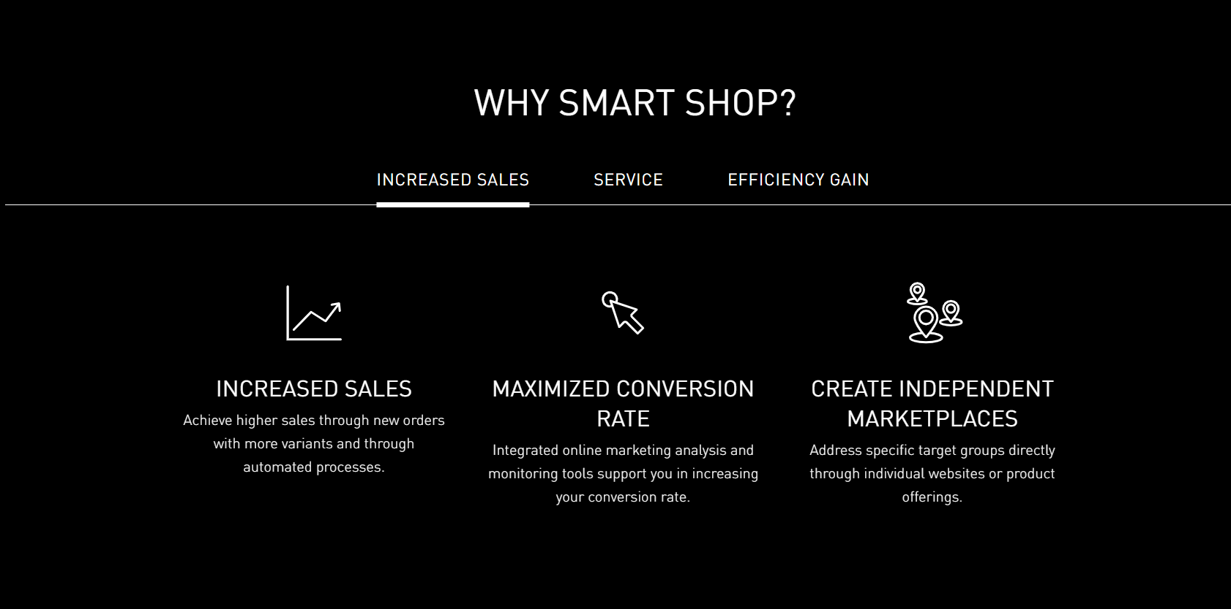

Slide 39

Web 2 Print - Durst digital printing (durst-group.com)
http://www.ieee.org

Slide 40
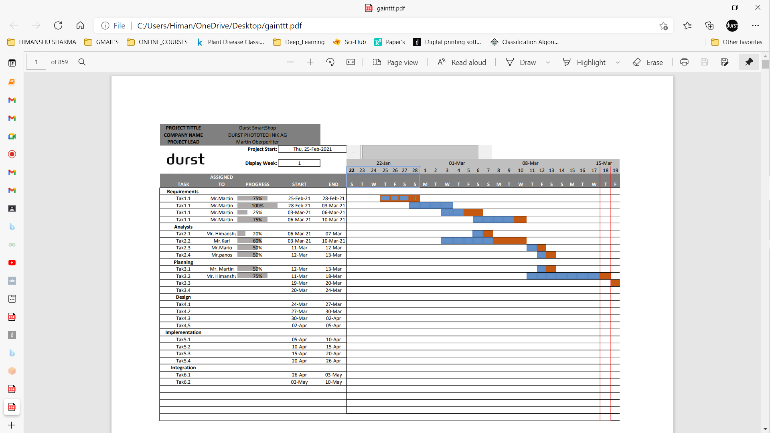
Gantt Chart

